Slide 1
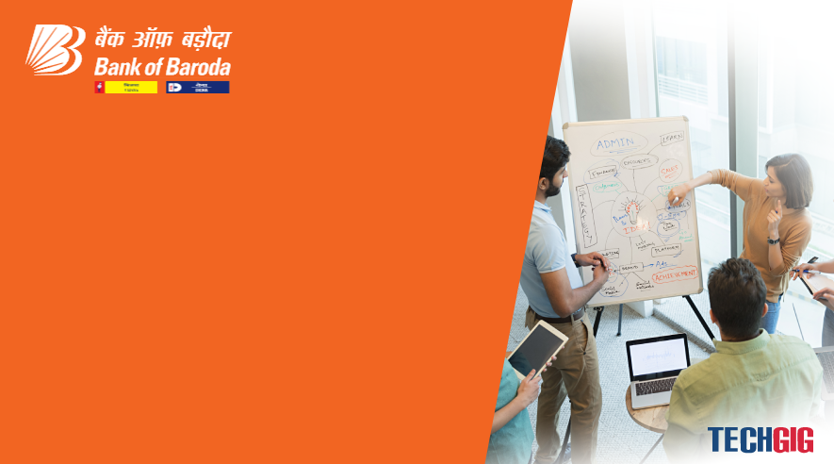

Bank of Baroda Hackathon - 2022
Technology Partner
Your Team Name : RUMI
Your team bio : As simple as it is.
Date : 13/09/2022

Slide 2
Problem Statement?
Why did you decide to solve this Problem statement?
I am a problem solver. No problem is big or small for me.
As soon as I encountered this problem I read about the bank check clearing process and there I came to know that as described in the problem clearing cheque is a tedious problem and it take lots of human efforts to do so.
So to deal with the problem I have decided to solve this problem.

Slide 3
User Segment & Pain Points
Which user /advertiser segment would be early adopter of your product & why?
Bank(s) will the early adopter of the the entire solution as far as the automatic cheque processing system is concerned beause it saves the huge amount of time of its employee on clearing the checks.
Moreover the user who are part of the system will also be the adopter of the sysytem . In order handle the fraudlent transaction user have to or is asked to give his concent for proceeding the check cleaing process. This will save user form any fraudelent transaction.

Slide 4
Pre-Requisite
What are the alternatives/competitive products for the problem you are solving?
There are several semi-automatic check processing system that are capable of substitution this proble as a solution. But most of them are just prototype and are not used commercially. There existing produc lacks automation as well as the security featues moreover they involves many human steps to make the system completely functional.

Slide 5
Azure tools or resources
Azure- python Azure-Image Processing Azure- Computer Vision (OCR)

Slide 6
Any Supporting Functional Documents
This solution will work on two parts
For the verification at the drawee bank:
-> Input will be a grey scale 100 DPI ( 8bit depth) JPEG image ( As recommended by RBI)
-> It will be divided into several essential
parts for identification purpose.
-> On extracting the details it will verify
the details of the customers and all
the security features.
-> It will verify the user and the balance
of drawer and then will ask the consent
of drawer to initiate the transaction.
For submission for checking at drawee Bank
-> Scan the cheque in the required form.
-> Extract the all essential information from
the cheque.
-> Send the cheque Image to the Drawee
bank based on the extracted information
using the CTS system and que for approval.
2) Provide the user interface for the submission of issued cheque for pre-checking or providing the consent for the initiation of the cheque process.

Slide 7
Key Differentiators & Adoption Plan
My suggested solution stands out of all the alternative because it use simple and fundamental processes of the automation . IT uses OCR, that will extract the communication and identifiable details out of the image.
It also stands on the RBI standards for the proceedings and will mould according in future also.
It posses all the security features for verification and data transmission (As specified in the RBI guidelines).
To avoid fraudulent Transaction Positive Pay and Reverse Positive Pay System is also included in the system.
For handling of unexpected situation manual input is also included to ease the process. For example, the payee name is not recognised , the system is unable to is unable to identify the details, in such cases the cheques will be handled manually.
For the cross verification purpose SAMPLING is also included. Nearly 20% of the cheques are selected randomly for the human verification to monitor the accuracy of the system.

Slide 8
GitHub Repository Link & supporting diagrams, screenshots, if any
For the verification of the RBI guidelines and Recommended standards Please refer following PDFs:
1)

Slide 9
Thank You
Kuldeep Chauhan

